Slide 1
Getting Started
Welcome & Practicalities
Week 1 / Lecture 1
Franck Chauvel
Axbit & NTNU
franck.chauvel@ntnu.no

Slide 2




About Me
Franck Chauvel, PhD
Software Engineer / Axbit
franck.chauvel@ntnu.no

Slide 3

Agenda
Algorithms and Data Structures?
Why to learn that?
Objectives
Prerequisites
Practicalities
Bibliography?

Slide 4

Algorithms?
Photo by Ron Lach from Pexels
Ordered sequence of instructions that solves a problem.
Manipulate data

Slide 5

Data Structures?
Photo by Dominika Roseclay from Pexels
How do we organize our ingredients?

Slide 6
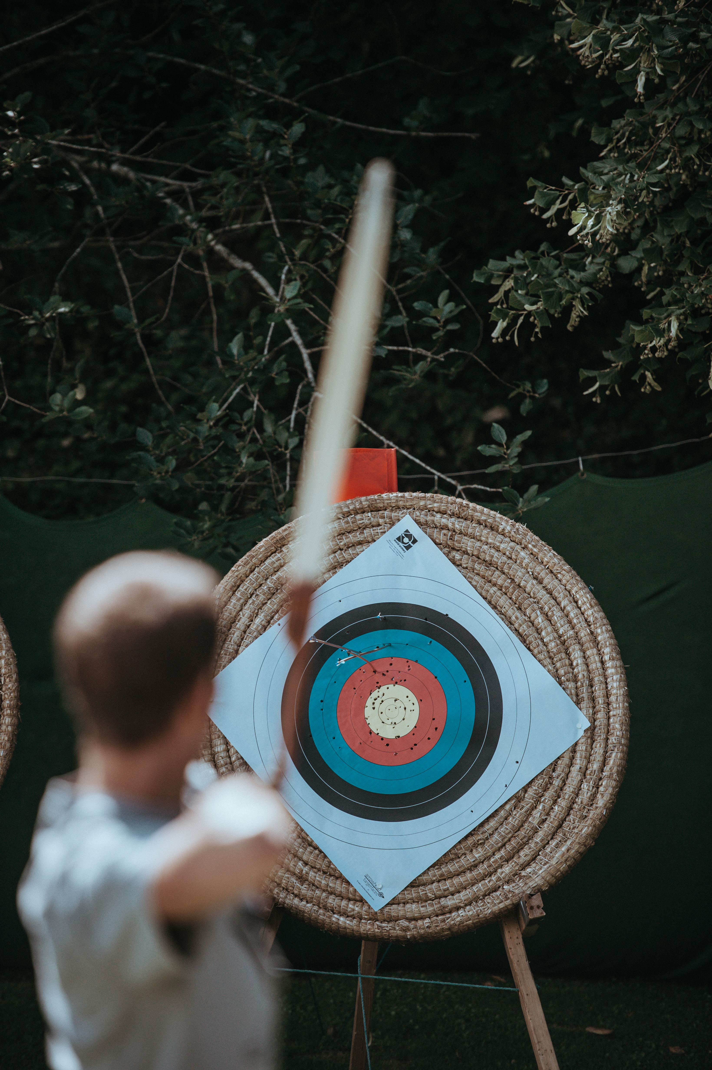
Objectives
Photo by Annie Spratt on Unsplash
Know the common problems
Know the most efficient solutions
Know how to design your own
Know how to evaluate alternatives

Slide 7
Syllabus
Foundations
Arrays
Lists
Sorting
Hashing
Trees
Graphs
Wrapping-up
correctness
big Oh
RAM
Searching
deletion
insertion
simple sorting
Calls & Recursions
Stacks & Queues
Recurrences
ADT
Quick sort
Merge sort
Radix sort
Chaining
Hash functions
Open addressing
Binary trees
Search trees
Self-balancing trees
Probing Further
directed graphs
cycles
spanning trees
A*
Sets
Parallel Computing
Quantum Computing
P vs. NP
Optimization
Pattern matching

Slide 8
Why?
“Computer Science is no more about computers
than astronomy is about telescopes”
attributed to Edsger W. Dijkstra (1930 – 2002)
Safe Investment
Everywhere AI, CV, DB, UI, Compilers, etc,
Useful for job interviews

Slide 9
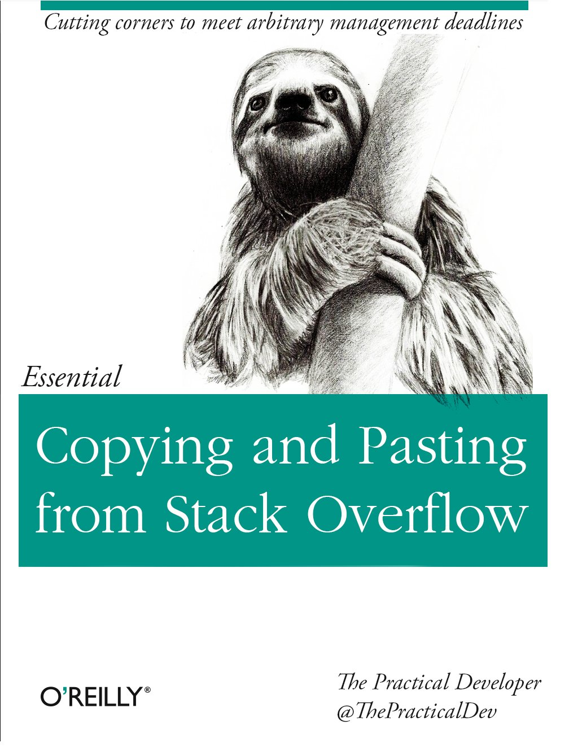
Some Programming The 1st prerequisite
Variables
Conditionals
Loops
Procedures calls

Slide 10
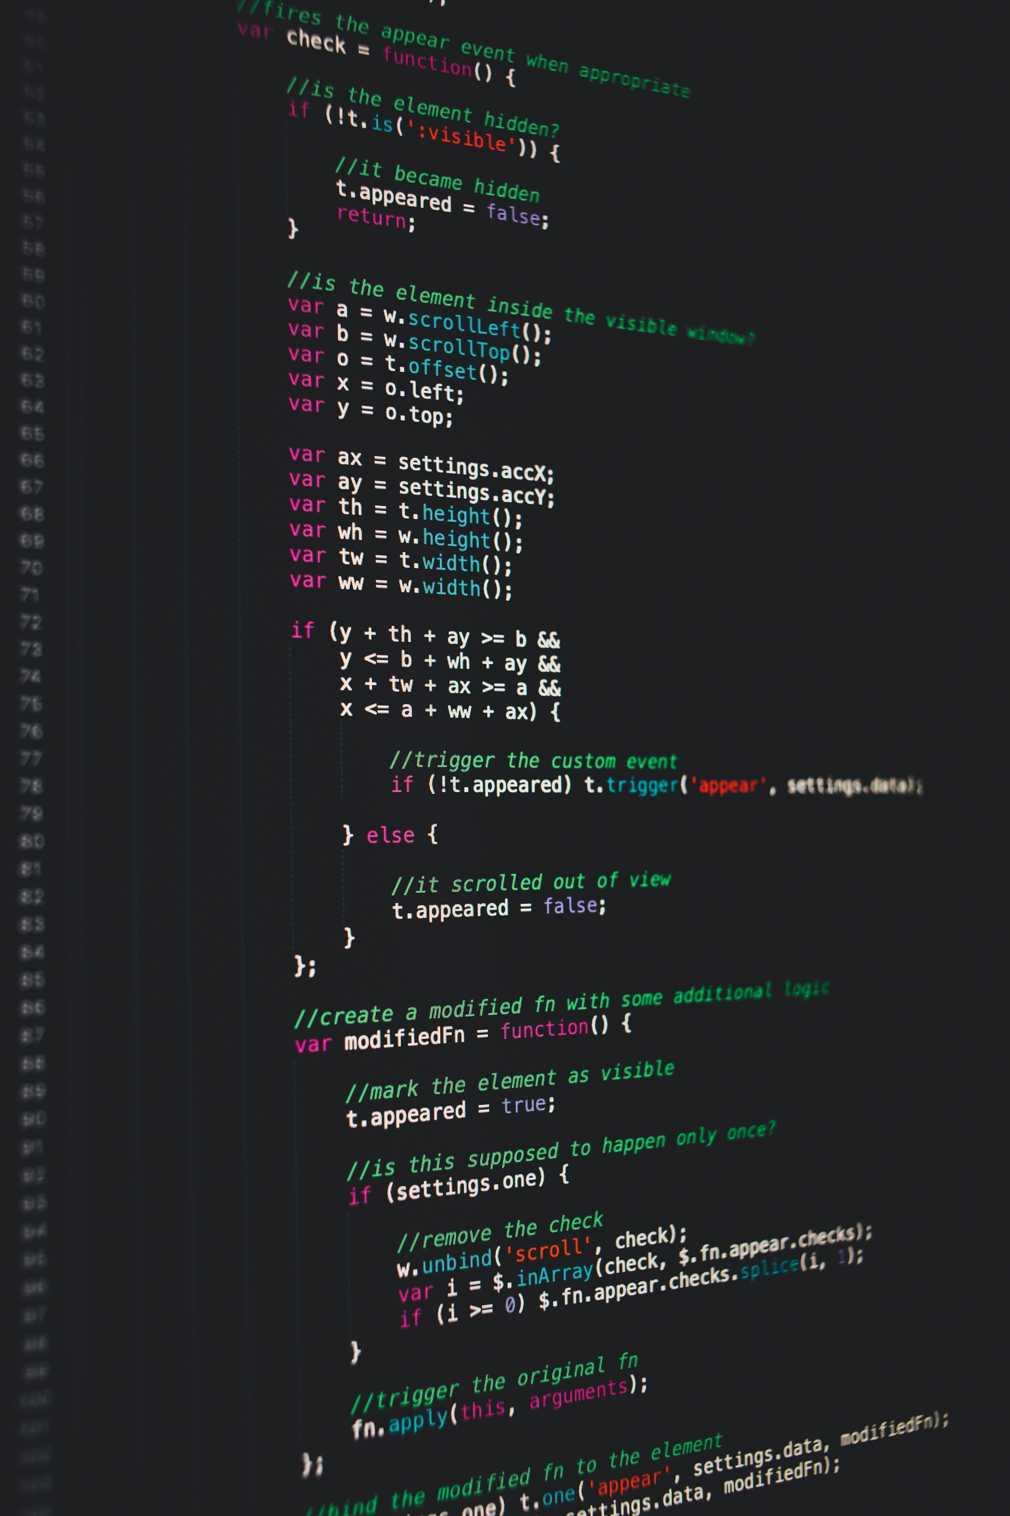
What Programming Language?
Lectures: C, Java, Python, Ruby, Javascript, LISP, etc.
Whatever suits you for the lab sessions.
Photo by Markus Spiske on Unsplash

Slide 11
Some Maths The 2nd prerequisites
High-school calculus
Probability
Recurences
Series

Slide 12
Practicalities
13 weeks + Exam
6 hours a week
2 hours of lectures
4 hours of lab session
(30 min + 1.5 hour) x 3
Weekly Quiz (optional)

Slide 13
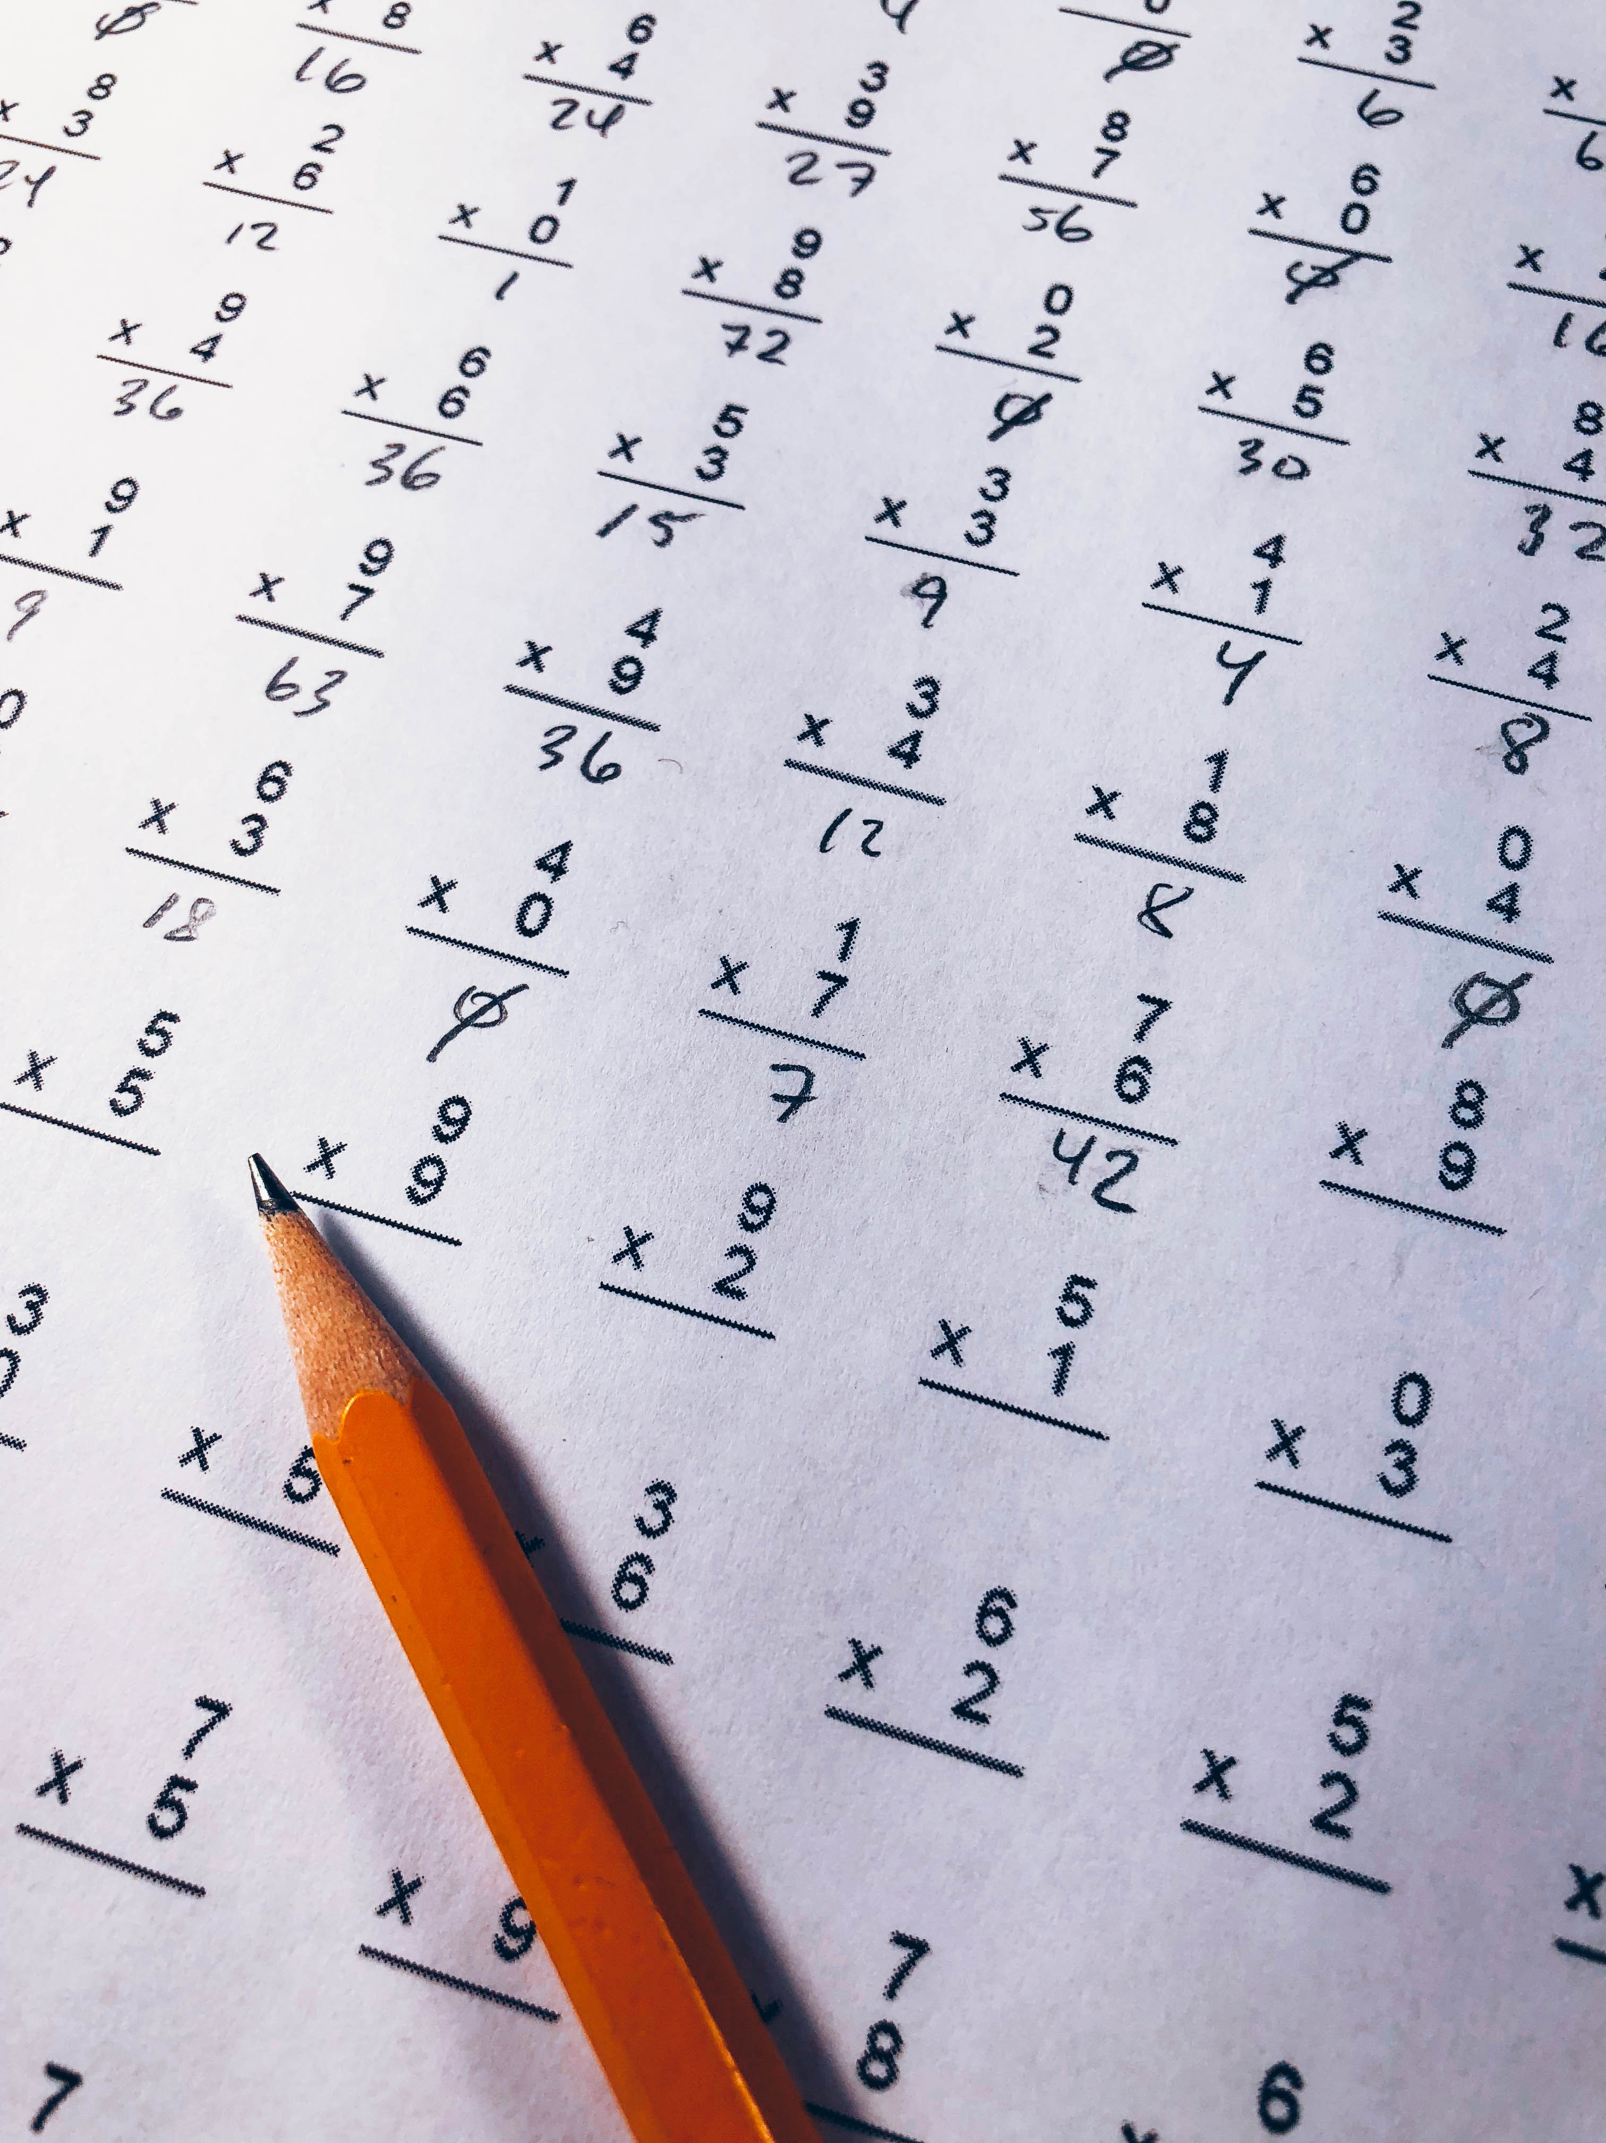
Exams & Grading
Week 14: Final written exam
Week ~8: Home Exam 1
Week ~4: Home Exam 2

Slide 14
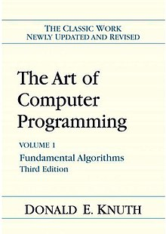
Bibliography
Knuth, Donald E.. The Art of Computer Programming, Vol. 1: Fundamental Algorithms. Third Reading, Mass.: Addison-Wesley, 1997.

Slide 15
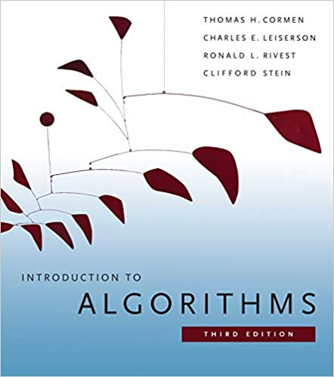
Bibliography
Thomas H. Cormen, Charles E. Leiserson, Ronald L. Rivest, and Clifford Stein. 2009. Introduction to Algorithms, Third Edition (3rd. ed.). The MIT Press.
1312 pages

Slide 16
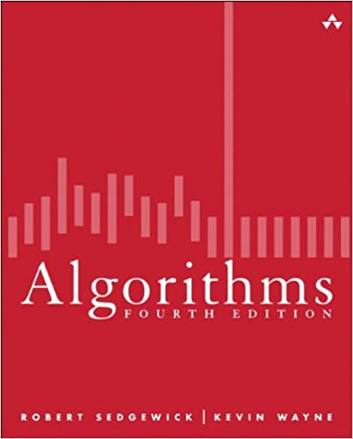
Bibliography
Sedgewick, R. & Wayne, K. (2011), Algorithms, 4th Edition. , Addison-Wesley .
976 pages

Slide 17
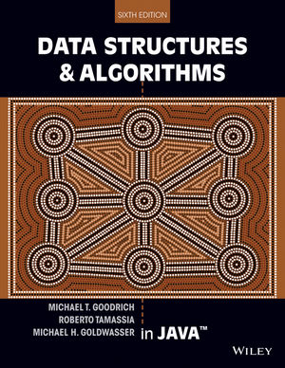
Bibliography
Michael T. Goodrich and Roberto Tamassia. 2003. Data Structures and Algorithms in Java (6th. ed.). John Wiley & Sons, Inc., USA.
656 pages

Slide 18
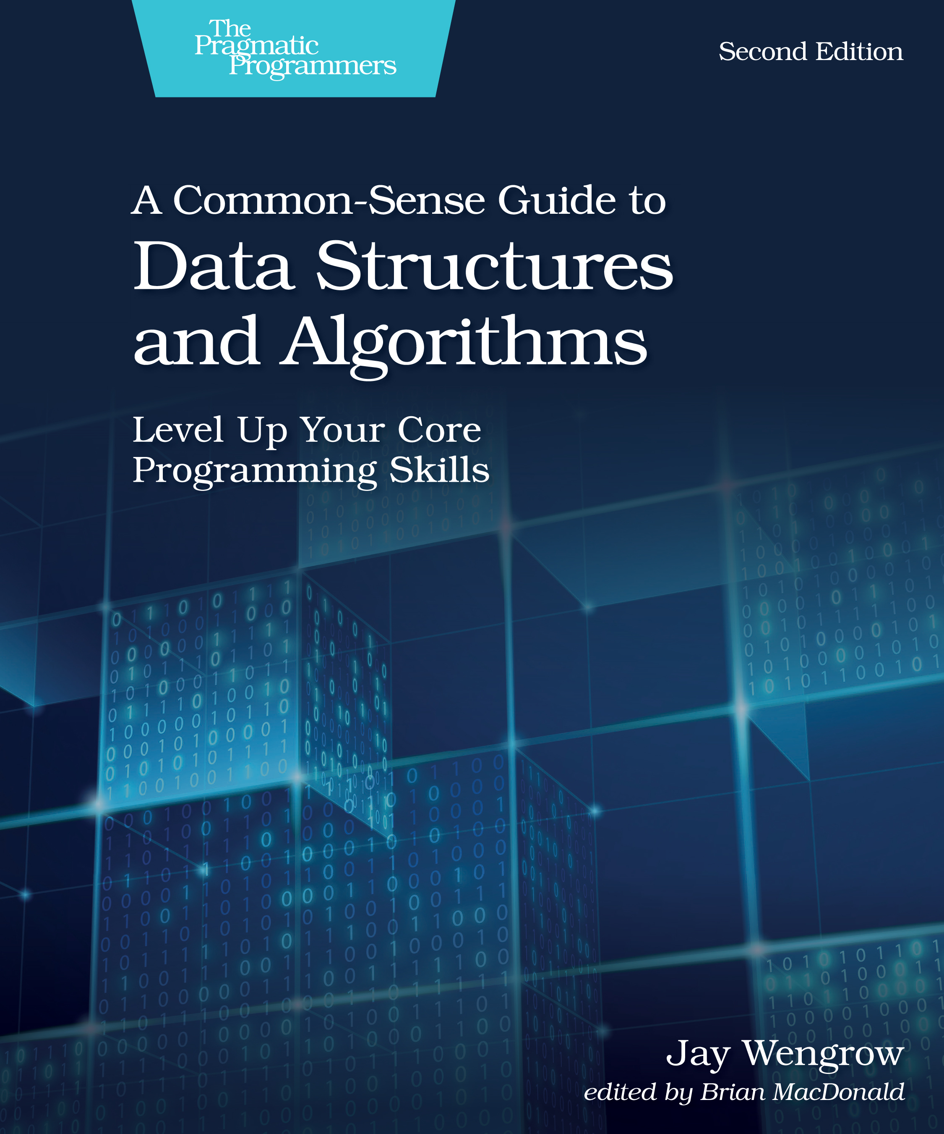
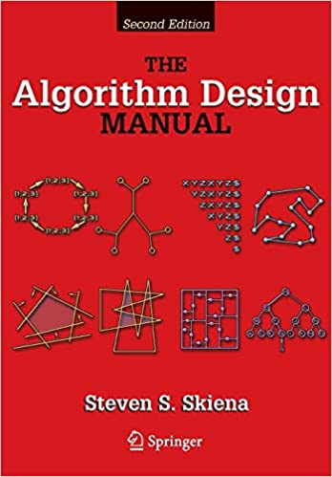
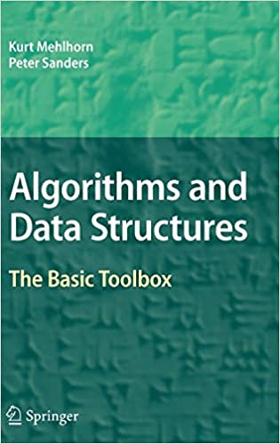
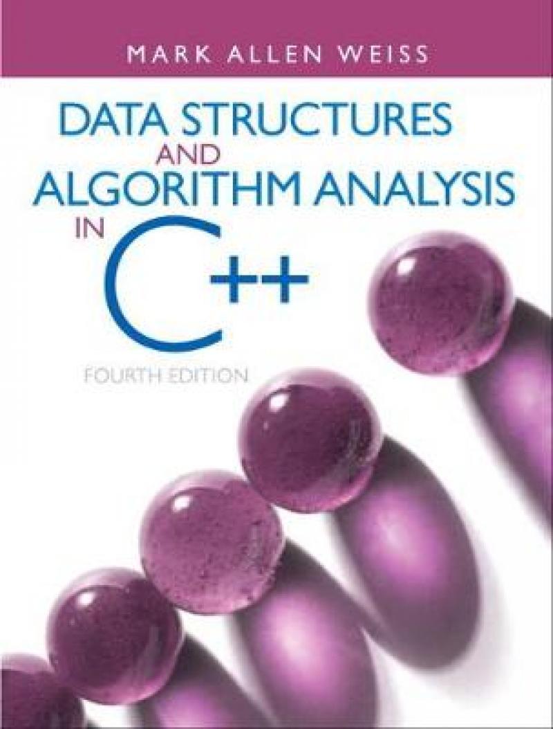
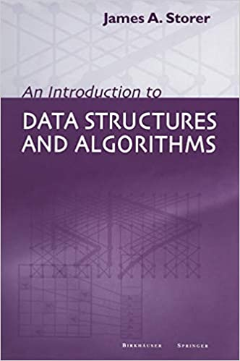
And Many More
Many MOOCs
Coursera
EdX
Udemy
Online Tutorials
Wikipedia
Geeks4Geeks
TutorialsPoints
etc.

Slide 19
Questions, Comments, or Ideas?
Franck Chauvel
Axbit & NTNU
franck.chauvel@gmail.com

